Slide 1
Indian Railway Inquiry System based on AVL Trees
By Alimulla Shaik

Slide 2
Agenda
Introduction
AVL Tree Operations
Insertion
Deletion
Run Time Analysis
Results

Slide 3
Introduction
AVL tree is self balancing binary search tree
Heights of the two child subtrees of any node differ by at most one
AVL trees will be helpful and efficient in application where search operation performed more frequently than insertion.
I have developed an application “Indian Railway Inquiry System” which efficiently uses all the operations of AVL trees.

Slide 4
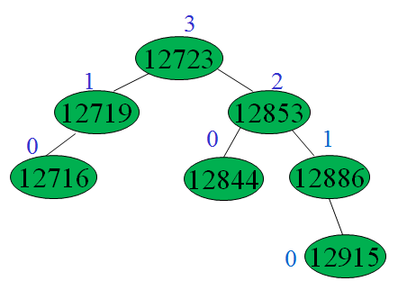
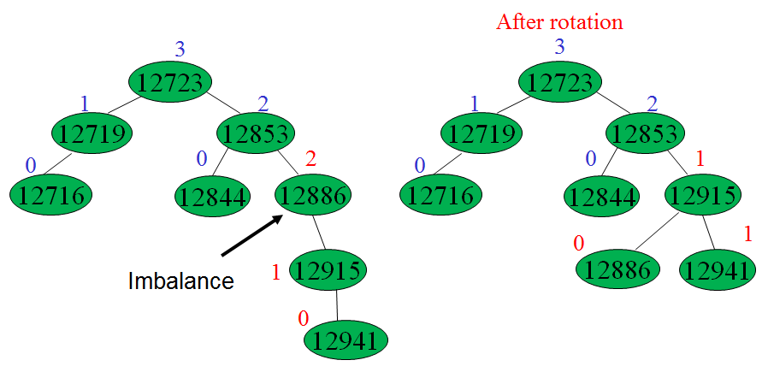
Operations
Insertion:

Slide 5
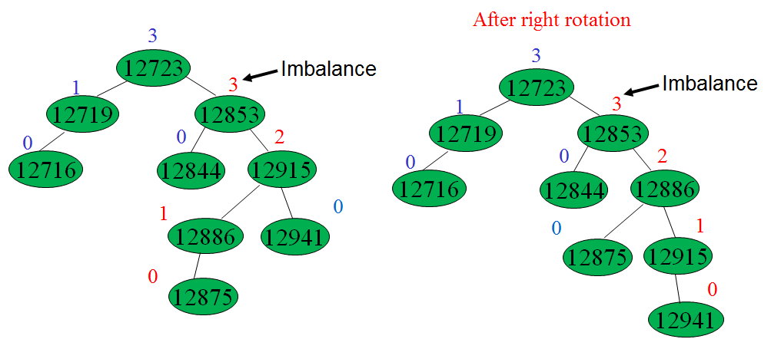
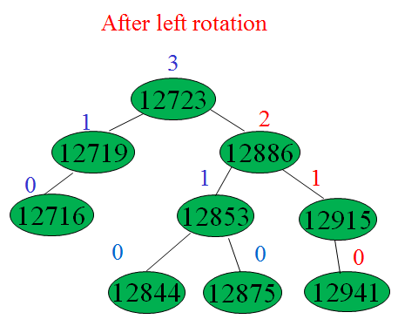
Insertion Conti...

Slide 6
Deletion
Deleting any node may imbalance the node’s parent
May need to make necessary rotation at the parent node and need to traverse all the way up the ancestry line, checking for balance and perhaps make some more rotations if required to fix the avl tree.
System will make rotations similar to the insertion cases described above.

Slide 7
Run Time Analysis
As our application based on the avl tree operations so it also have the same complexity or running time as avl tree which is O(logn).
Our application need to store all the nodes of the tree and for n nodes O(n) space required to perform necessary operations.

Slide 8
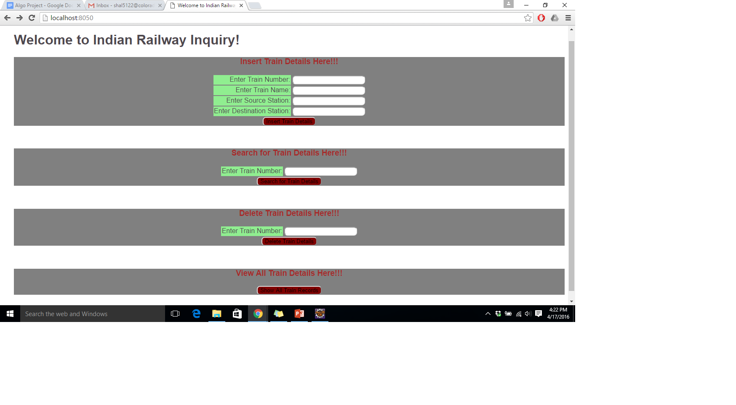
Results

